Slide 1


High Level Synthesis for FPGA:Bridging Software and Hardware
Ikramul Hassan Sazid
Hamm-Lippstadt University of Applied Sciences
Hardware / Software Codesign - SS26
Prof. Dr. Achim Rettberg

Slide 2
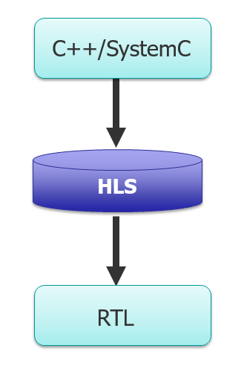
INTRODUCTION: High-Level Synthesis (HLS)
The Driving Motivation: The complexity of System-on-Chip (SoC). High level coding to significantly improve developer productivity.
Core Concept Defined: HLS is the automated process that translates untimed or partially timed high-level specifications (like C, C++, or SystemC) into a low-level, cycle-accurate RTL representation.
Output Definition: The final output of the HLS compilation process is a synthesizable RTL netlist.
Target Implementation: On FPGA similar to RTL netlist
[1]

Slide 3
History and Previous Limitations of HLS
Early Origins (1980s–1990s): Early HLS initiatives (often called behavioral compilers) attempted to raise the abstraction level. However, first-generation tools primarily used hardware description languages (HDLs) as inputs rather than software languages.
Key Limitations of Early Tools:
Poor Quality of Results (QoR): highly variable and unpredictable RTL, inefficient resource allocation.
Misaligned Target Audience: RTL designers (resisted paradigm shift) instead of empowering software and algorithm engineers.
Validation Challenges: Unreliable timing behaviors in the generated RTL, design verification extremely difficult.

Slide 4
The FPGA Perspective
Generates RTL specifically optimized to map onto a fixed, discrete fabric ie. LUTs, Flip-Flops (FFs), Hardened DSP slices, and Block RAMs)
Unlike GCC, FPGA HLS compilers like Vitis HLS is “Target-Aware”
Contains internal databases of the exact routing delays, multiplexer structures, and resource counts of specific FPGA
Maps data to BRAM for high memory bandwidth

Slide 5



Mathematical Modeling & Scheduling for FPGAs
The SDC Framework (O(n) Complexity)
Assigns a single continuous variable (s) to represent the start clock cycle of each operation.
Modeling Data Dependencies
Operations are mathematically separated by constant delays (d).
(Operation j must wait for i to finish)
Modeling FPGA Resource Limits
The scheduler cannot exceed the exact physical limits of the target FPGA fabric (DSPs, LUTs, BRAMs).
(Scheduled Resources < Available Chip Resources)
The Total Unimodularity Guarantee
Objective: (Minimize Latency)
SDC constraint matrix guarantees that the standard LP solver will natively return fast, whole-integer clock cycles without expensive algorithms.

Slide 6


The HLS Algorithm and Compilation Flow
Front-End Compilation: Modern tools parse C/C++ code into an Intermediate Representation (IR) utilizing compiler infrastructures such as LLVM.
Algorithms like Static Single Assignment (SSA) are strictly employed for constant propagation and dead code elimination.
Optimizing Soft Constraints: The scheduler algorithm incorporates "soft" constraints (e.g., pipeline stage preferences) by introducing a violation variable (v_j) and a penalty term (φ (v_j)) into the objective function.
Modified Objective: Minimize c^T s + ∑ φ (v_j).
Subject to: and
Datapath Generation: Ultimately, scheduling, allocation, and binding work concurrently to generate RTL from a control-and-datapath flow graph (CDFG).
[8]

Slide 7
Runtime, Complexity, and Current Advancements
Scalable Compilation (The Power of SDC)
The mathematical "unimodularity" guarantees fast, whole-integer clock cycles.
Avoids slow, exponential problem-solving, allowing HLS to compile even massive, modern FPGA designs in minutes.
The Compiler Trade-off
Tools must balance squeezing out the absolute maximum hardware efficiency (lowest LUT/DSP count) against keeping compile times fast and the output RTL readable.
[3]

Slide 8
Runtime, Complexity, and Current Advancements
Modern FPGA Advancements
Task-Parallelism: Moving beyond simple for loops to design complex, concurrent streaming data paths directly in C++.
Rapid Debugging: Verifying logic using instantaneous C++ software simulation instead of agonizingly slow RTL waveform simulators.
AI/ML Integration: Tools now use Machine Learning to predict physical routing congestion on the FPGA silicon before standard synthesis even begins.
[3]

Slide 9
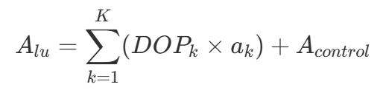
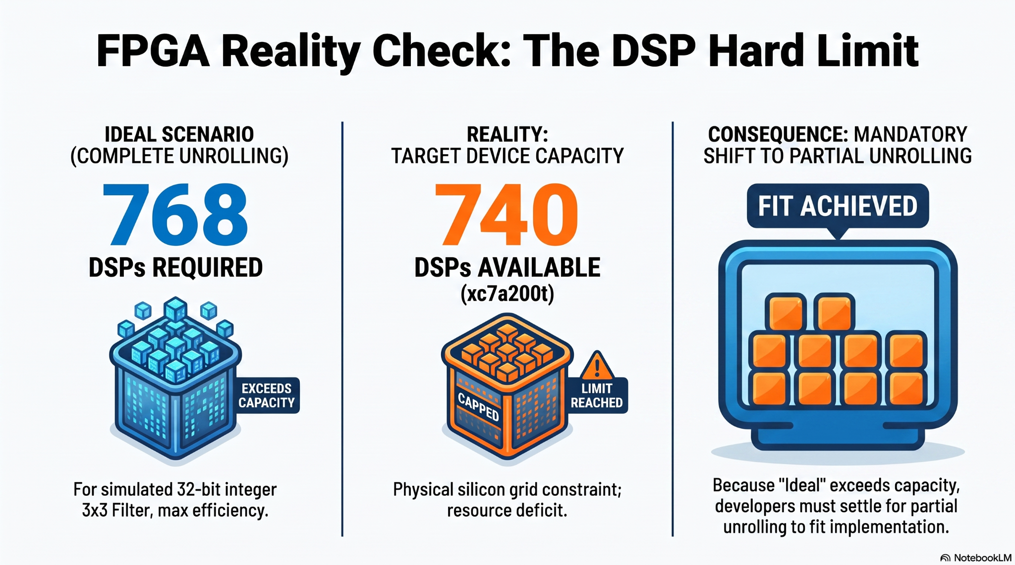
Unwinding Effects on the hardware area of an FPGA
Multiplying Hardware Components: Degree of parallelism , DOPk
The Physical Area Constraint (A): optimized area must strictly remain less than the total available device area: Alu <A
[8]

Slide 10
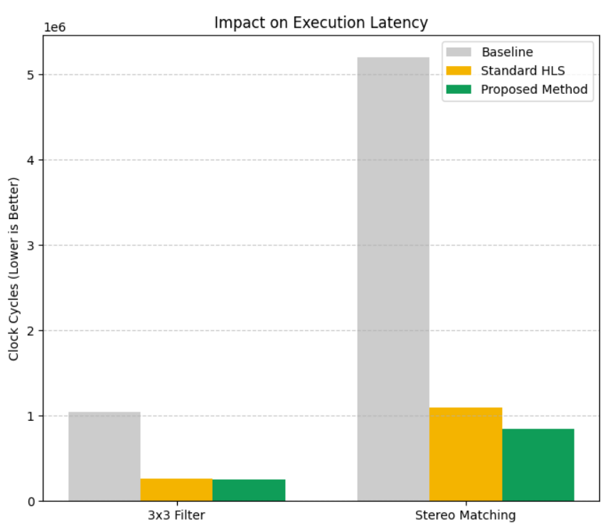
Simulated Results: Code Optimization in Practice
The Benchmarks
Evaluated across two real-time image processing algorithms ( 3 X 3 Filter, Stereo Matching).
Reduced Latency (Faster Execution)
Simplifying the C/C++ loop hierarchies exposed deeper instruction-level pipelining opportunities for the HLS scheduler.

Slide 11
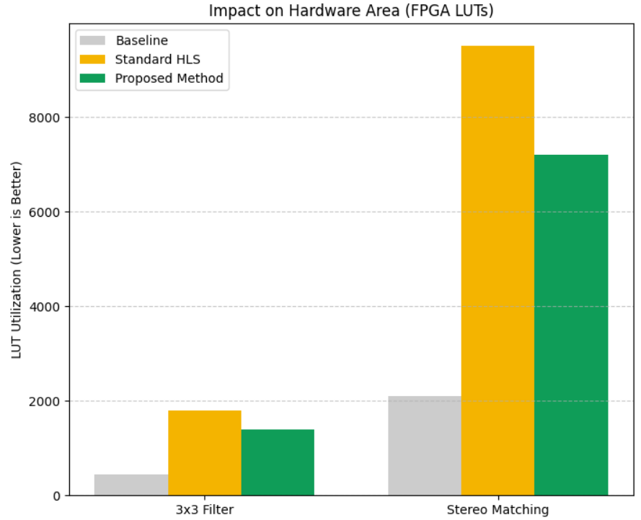
Simulated Results: Code Optimization in Practice
Reduced Hardware Area (Fewer Resources)
Cleaner mathematical representation of the code required significantly less complex control logic (fewer LUTs/Registers) during synthesis.
Proposed Method
Combining intelligent source-code restructuring with standard HLS pragmas yields much higher efficiency than relying on the compiler alone.

Slide 12
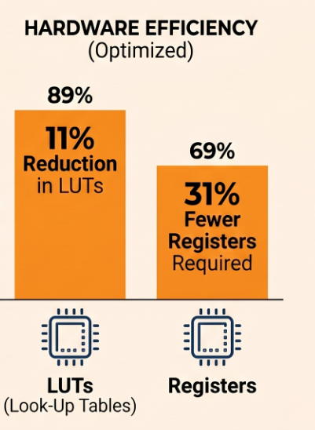
Realization of Application Examples
Case Study 1: MIMO Sphere Decoder: A multi-input multi-output wireless system application.
Architecture: HLS achieves a highly parallel streaming dataflow architecture.
Results: Yielded an 11% reduction in Look-Up Tables (LUTs) and a 31% reduction in registers compared to hand-coded RTL, in roughly the same or less development time.
[8]

Slide 13
Conclusion
Continual algorithmic advancements have made HLS fiercely competitive with manual RTL. Modern tools provide excellent quality of results (QoR) and resource utilization, genuinely saving time and effort compared to writing VHDL or Verilog manually.
[8]
…
Questions?

Slide 14
References:
https://www.vlsi-expert.com/2021/05/high-level-synthesis-intro.html [Accessed: Jun. 22, 2026].
Y. Chi, L. Guo, J. Lau, Y. Choi, J. Wang, and J. Cong, "Extending High-Level Synthesis for Task-Parallel Programs," in 2021 IEEE 29th Annual International Symposium on Field-Programmable Custom Computing Machines (FCCM), 2021, pp. 204-213, doi: 10.1109/fccm51124.2021.00032
C. Li, Y. Bi, Y. Benezeth, D. Ginhac, and F. Yang, "High-level synthesis for FPGAs: code optimization strategies for real-time image processing," Journal of Real-Time Image Processing, vol. 14, pp. 701-712, 2018, doi: 10.1007/s11554-017-0722-3.
Z. Kou et al., "High-Level Synthesis Design of Scalable Ultrafast Ultrasound Beamformer With Single FPGA," IEEE Transactions on Biomedical Circuits and Systems, vol. 17, pp. 446-457, 2023, doi: 10.1109/TBCAS.2023.3267614.
J. Cong, B. Liu, S. Neuendorffer, J. Noguera, K. Vissers, and Z. Zhang, "High-Level Synthesis for FPGAs: From Prototyping to Deployment," IEEE Transactions on Computer-Aided Design of Integrated Circuits and Systems, vol. 30, no. 4, pp. 473-491, Apr. 2011, doi: 0.1109/TCAD.2011.2110592
.
S. Lahti and T. D. Hämäläinen, "High-Level Synthesis for FPGAs—A Hardware Engineer’s Perspective," IEEE Access, vol. 13, pp. 28574-28593, 2025, doi: 10.1109/ACCESS.2025.3540320
LLM generated image

